Slide 1
CommonSensei
By AI lmao

Slide 2



Slide 3
Relevance and Impact
Personalised teacher-like consultation through an app on their phones
One-to-one attention can be given to every student.
Expensive human resources
Questions answered on demand to maximise productivity

Slide 4

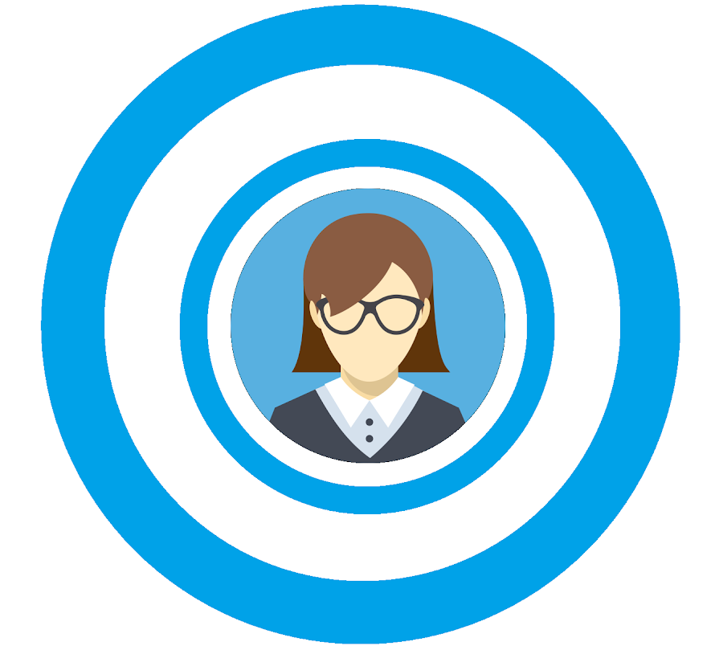

Slide 5
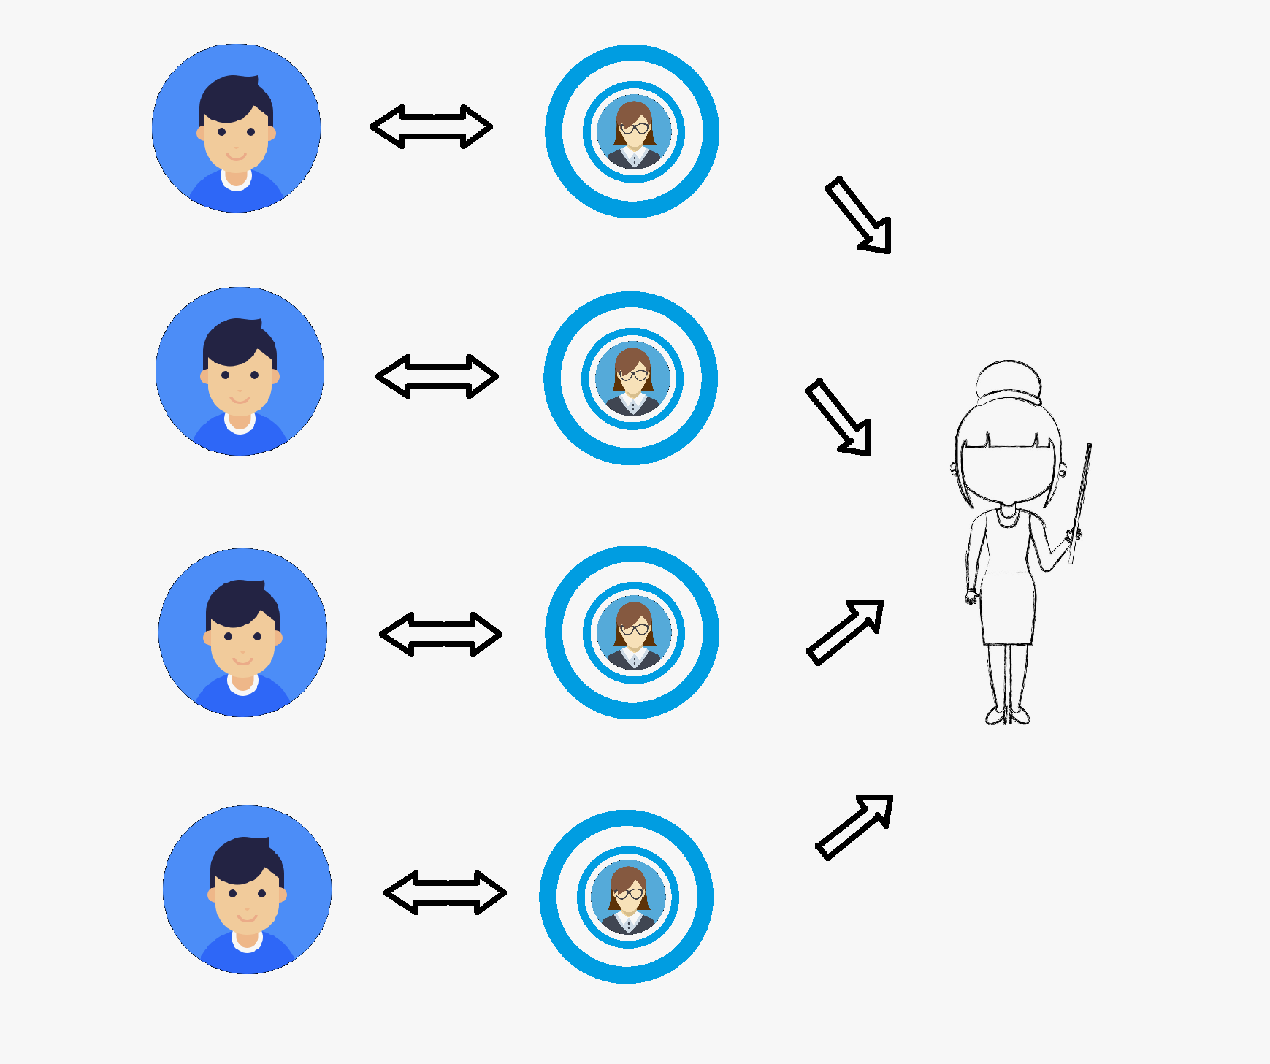
Uniqueness and Feasibility
reduces manpower required in the education sector and yet increases attention paid onto every student.
Unique use of AI provides personalised responses to each student at each student is different.
In the education sector, just acquiring knowledge is not enough. By adding the human touch (without using real humans) gives the students a healthier mental growth

Slide 6



Append New
User Message/Input
Database
Webpage Portal
Front-End
Add new event?
Add new task?
Next task?
Reply
Reply/Output

Slide 7
DEMO

